Slide 1
Python week 1
Canberra Chinese School Sem3

Slide 2

Review (Variables)
Data Types & Variables:
Strings (text), Integers (whole numbers), Floats (decimals), Booleans (True/False).
Type conversion (e.g., int(), str())
User input with input()
Lists

Slide 3
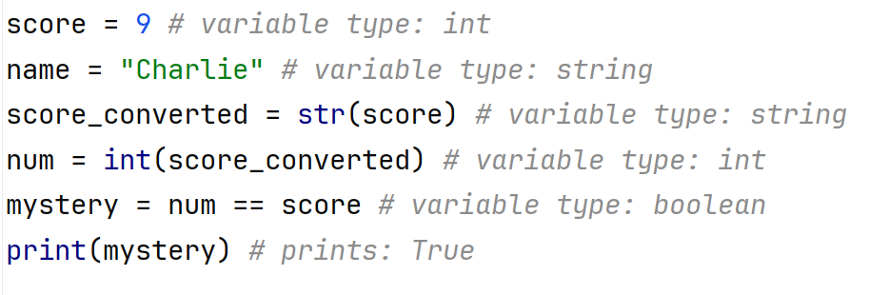
Review (Variables)

Slide 4
Review (lists)
Lists:
0-based indexing: first item is list[0].
Access/modify elements: names[n].
Operations: append, remove, etc.
Lists can store mixed types.

Slide 5
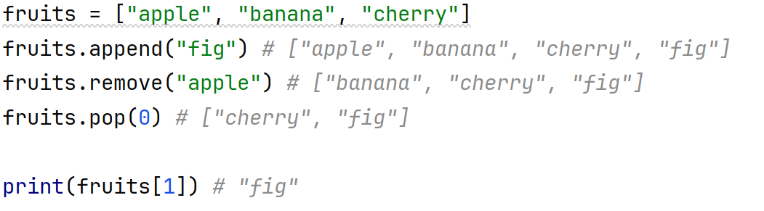
Review (lists)

Slide 6
New topic: list comprehension
If we want to create a list of the first 5 even positive numbers, what can we do?

Slide 7

New topic: list comprehension
If we want to create a list of the first 5 even positive numbers, what can we do?
That’s simple enough.
But what if we want to create a list of the first 100 even positive numbers? Wouldn’t writing out each number manually be quite a hassle?

Slide 8
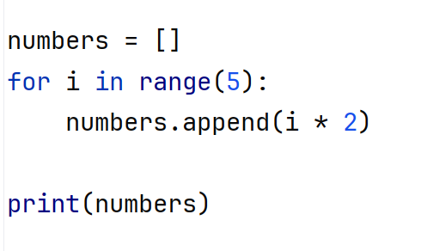

New topic: list comprehension
Let’s try this.
This prints because i starts at 0 and ends at 4, but we want 2,4,6,8,10. so what should we do instead?

Slide 9
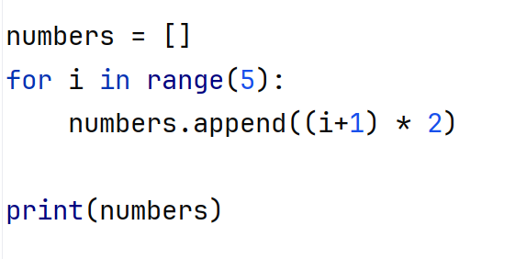

New topic: list comprehension
Approach 1:
This prints

Slide 10
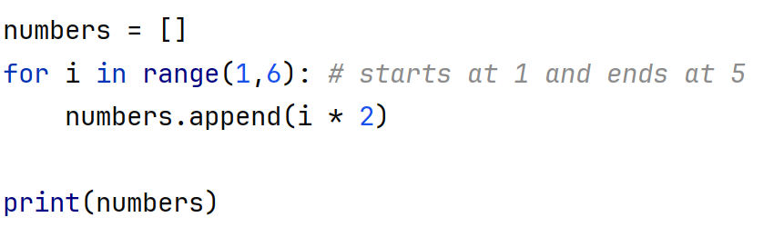
New topic: list comprehension
Approach 2:
This also prints

Slide 11
New topic: list comprehension
So if we want a list of the first 100 positive even numbers…

Slide 12
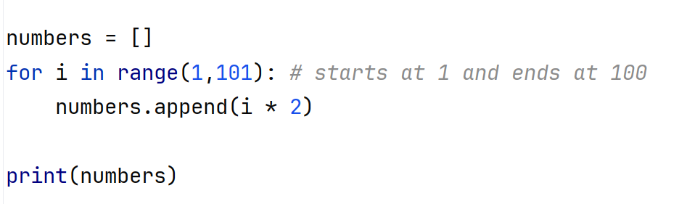
New topic: list comprehension
So if we want a list of the first 100 positive even numbers…
This prints … all the way to 200

Slide 13
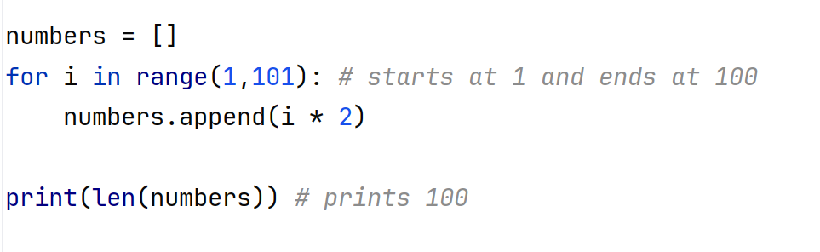
New topic: list comprehension
We can verify that it is the first 100 positive even number by checking the length of our list

Slide 14
New topic: list comprehension
Exercise: write a script that creates a list of the first 100 odd numbers

Slide 15
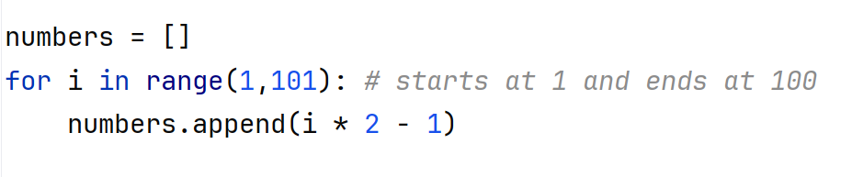
New topic: list comprehension
Exercise: write a script that creates a list of the first 100 odd numbers
We simply put a minus 1 after i * 2.

Slide 16
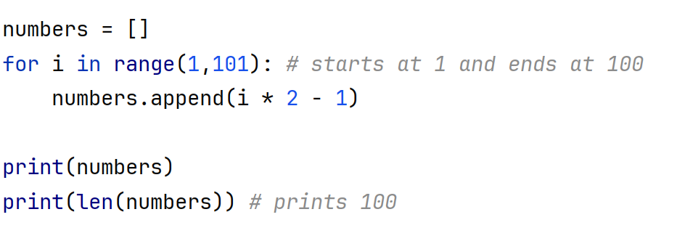
New topic: list comprehension
Exercise: write a script that creates a list of the first 100 odd numbers
To verify:

Slide 17
New topic: list comprehension
Exercise: write a script that creates a list of the first 100 positive multiples of 5.
List looks like [5, 10, 15, 20, …, 495, 500]

Slide 18
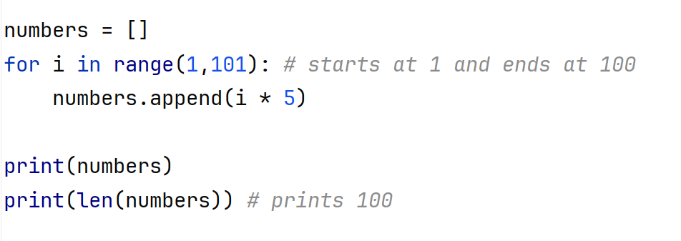
New topic: list comprehension
Exercise: write a script that creates a list of the first 100 positive multiples of 5.

Slide 19
New topic: list comprehension
Exercise: write a script that creates a list of the first 100 squares of positive numbers.
List will look like [1, 4, 9, 16, 25, …, 9801, 10000]

Slide 20
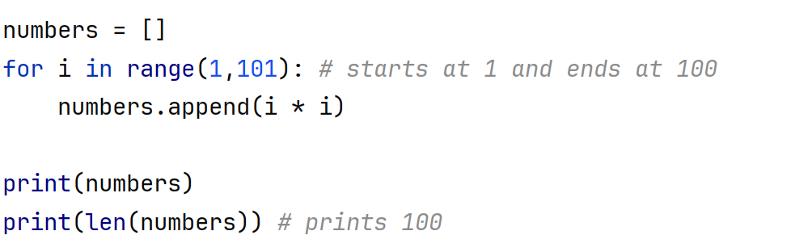
New topic: list comprehension
Exercise: write a script that creates a list of the first 100 squares of positive numbers.

Slide 21
New topic: list comprehension
Fibonacci sequence is a sequence that starts with 0 and 1, and each term after is the sum of the two preceding terms.
It looks like this:
0, 1, 1, 2, 3, 5, 8, 13, 21, 34, 55…

Slide 22
New topic: list comprehension
Homework: write a script that creates a list containing the first 100 terms (at least) of the Fibonacci sequence
The list should look like this:
0, 1, 1, 2, 3, 5, 8, 13, 21, 34, 55… all the way to really really large numbers

